Slide 1
Analyzing Open-Source Data to Inform Military Vehicle Design
Benjamin S. Lynch | Vikram Mittal, PhD
Department of Systems Engineering, United States Military Academy
2026 NDIA Michigan GVSETS | Open Technical Session | Novi, MI | Aug 11–13, 2026
DISTRIBUTION STATEMENT A. Approved for public release; distribution is unlimited.

Slide 2
The Acquisition Mismatch
Modern battlefields evolve faster than we can design for them.
Major vehicle programs take decades from concept to fielding; even upgrade packages take years.
Requirements rely on classified reporting, post-conflict studies, and controlled testing = slow feedback loops.
Meanwhile, the Russia–Ukraine war generates unprecedented public data on vehicle employment, damage, and loss in near real time.
Can open-source intelligence systematically inform vehicle design before the next conflict?

Slide 3
Military Vehicle Design Lives in a Trade Space
Survivability, lethality, and mobility are in constant tension.
More armor adds weight and costs mobility. More firepower drives weight, power, and crew demand. Cost constrains how many platforms can be fielded.
Each vehicle class sits at a different point in this triangle, and that point is shifting as the battlefield evolves.

Slide 4
Proposed Methodology
Data Collection
Data Processing
Dataset Integration
Analysis
Interpretation & Implications
Narrative reporting (news sources)
Verified loss data (OSINT datasets)
Extract vehicle-specific context windows
Code operational conditions
Standardize loss data (temporal intervals)
Align narrative and loss datasets over time
Define loss vs non-loss periods
Compare operational conditions across periods
Conduct statistical tests (chi-square)
Assess links between design and attrition
Compare with doctrine
Inform future design and force employment

Slide 5
Combining Narrative Reports with Confirmed Losses
ISW Campaign Assessments
Oryx Loss Records
Two data streams
ISW campaign assessments
Daily narrative parsed for Leopard mentions
Each mention tagged by operational context
Oryx loss records
Visually confirmed losses, geolocated
Aggregated weekly for time alignment
Aligned via chi-square tests of independence.
Cleaned text · 844 reports
Visually confirmed losses
Context windows
1,837 excerpts
Weekly aggregation
Tagged by operational context
Variants collapsed to Leopard
Chi-square tests of independence

Slide 6

Institute For The Study of War

Slide 7
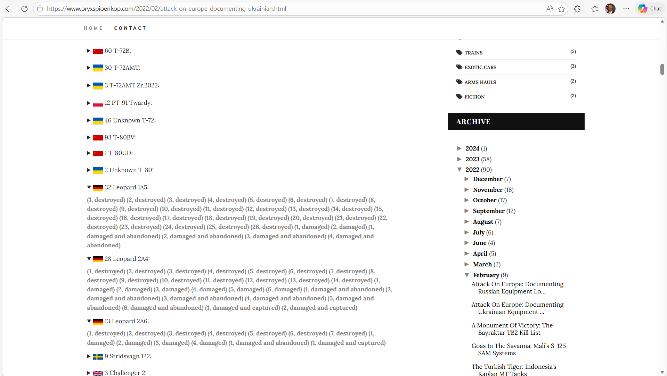
Oryxspioenkop

Slide 8
Case Study: Leopard in the Russia–Ukraine War
LEOPARD 2 : Platform Profile
Why this platform?
Recent NATO transfer. Leopard 1A5, 2A4, and 2A6 sent to Ukraine starting 2023.
Mixed fleet, varied conditions. Operating without full NATO sustainment.
Extensively documented. High signal-to-noise in open sources.
A test of how design trade-offs hold up in a transparent battlespace.
Origin
Federal Republic of Germany, introduced 1979
Variants in theater
Leopard 1A5, 2A4, 2A6
Combat weight
~60–65 tons (configuration dependent)
Powerpack
1,500 hp diesel
Main gun
120 mm smoothbore (L55 on 2A6)
Survivability
Modular composite armor, mine protection, top-attack mitigation, crew survivability features
Doctrinal role
NATO maneuver warfare, combined-arms shock and exploitation

Slide 9
Finding 1: Narrative Volume Does Not Track Attrition
If reporting volume reflected attrition, the two signals would rise and fall together. They don't.
59
weeks with confirmed Leopard losses
10
of those also appeared in ISW narratives
17%
overlap between narrative and attrition
Coverage also declined over time. 2023 heavy → 2024 lighter → 2025 nearly absent, even as losses continued.
Open-source narrative reflects salience, not tempo.

Slide 10
Finding 2:What Operational Conditions Track With Losses
Only minefields and drone ISR show statistically significant association with Leopard losses.

Slide 11
Losses Reflect a System, Not a Direct-Fire Duel
DRONE / ISR
★ p = 0.0041
Losses are not "high combat intensity."
They cluster where:
Maneuver is restricted by obstacle belts
Concealment is degraded by persistent ISR
Targeting is enabled by linked sensors and fires
EW and air defense thicken the kill chain
Survivability is a system property, not a platform property.
Logistics
Artillery
Defensive Ops
LEOPARD
EW / Air Def
MINEFIELDS
★ p = 0.0107
Concentric layers around the tank: each ring is part of the integrated threat system.

Slide 12
From Findings to Design Choices
EXISTING PLATFORMS
Near-Term
FUTURE PLATFORMS
Long-Term
Counter-UAS protection
Add-on hard- and soft-kill kits, top-attack defense, hemispheric awareness.
Signature management
Reduce thermal, RF, and visual signatures; on-demand obscurants during breach exposure.
Engineer integration
Co-located breach and route-clearance assets inside the formation.
Reduced baseline signature
Lower thermal, acoustic, and radar profiles designed in from the start.
Distributed / optionally manned
Architectures that distribute risk across crewed and uncrewed nodes.
Networked sensing and fires
Designed to operate inside a layered sensor-shooter fabric, not standalone.
Prioritization is data-driven: design dollars follow the conditions most associated with attrition.

Slide 13
Conclusions and Contact
1. Open-source data can inform vehicle design.
Narrative and confirmed-loss data together ground requirements in observed combat.
2. Coverage volume is not a proxy for losses.
In case study, only 17% of loss weeks were covered, and salience faded over time.
3. Modern survivability is system-level.
In case study, minefields and drone ISR drive losses. Counter-UAS, signature, and breach support are design priorities.
Limitations
Selection bias in what is shared publicly
Misinformation risk, growing with genAI
Statistical associations, not causation
Contact
Dr. Vikram Mittal
USMA · Dept. of Systems Engineering
Vikram.mittal@westpoint.edu
845-938-5507

